Slide 1

Proactive Retention
Predicting Credit Card Customer Churn
Presented by: Vansh Kumar

Slide 2
The Challenge: Customer Churn
Understanding and addressing customer attrition is a critical challenge for the bank, impacting both revenue and market share.
The Challenge:
The Cost:
The Objective:
The bank is experiencing customer attrition (churn), reducing revenue and market share
Acquiring new customers is significantly more expensive than retaining existing ones
Build a Machine Learning model to predict which customers are likely to close their accounts
Enable the marketing team to intervene proactively based on data, not guesses

Slide 3

Understanding the Data
A crucial first step in predicting customer churn is to thoroughly understand the dataset we're working with. This overview details the structure, content, and initial challenges of our credit card customer data.
Data Source
Volume
BankChurners.csv(Credit Card customers)
10,127 records (Rows)
with 20 features (Columns)
Data Cleaning
Target Variable
Removed CLIENTNUM (ID)
Attrition_Flag
Removed "Naive_Bayes" columns (data leakage artifacts)
0 = Existing Customer
1 = Attrited Customer

Slide 4
The Challenge: Class Imbalance
Only 16.07% of customers churned.
A naive model could guess "Stay" every time and still be 84% accurate, but useless.
This is the class imbalance problem we must address to build a truly predictive model.

Slide 5
Technology Stack & Approach
Language
Python 3.x
Data Processing
pandas & numpy: For data ingestion, cleaning, and manipulation
Visualization
matplotlib & seaborn: Used for EDA and plotting Confusion Matrices
Machine Learning (Scikit-Learn & XGBoost)
StandardScaler: To normalize data for Logistic Regression
train_test_split: To create a validation set (stratified)
SMOTE: To synthesize data for the minority class
XGBClassifier: The primary gradient boosting algorithm used

Slide 6
Key Insights from Exploratory Data Analysis
Transaction Count (Total_Trans_Ct)
Revolving Balance
Product Depth
Customers with a $0 balance are higher risk (indicates the card is inactive/unused)
Customers with 3+ products (Savings, Loans, etc.) are significantly more loyal
The strongest predictor
Customers with high transaction frequency rarely churn
Customers who carry a balance are "stickier"
Those with only the credit card are at higher risk
Low frequency is a major "Red Flag"

Slide 7


Model Building Strategy
Preprocessing Pipeline
Encoding
Splitting
One-Hot Encoding for categorical variables (Gender, Marital Status)
80% Training / 20% Testing (Stratified to keep churn rate consistent)
Handling the Imbalance (16% Churn)
Strategy A (Logistic Regression)
Strategy B (XGBoost)
Applied SMOTE (Synthetic Minority Over-sampling Technique) to artificially balance the training data
Applied scale_pos_weight to heavily penalize the model for missing a churner

Slide 8
Model Performance & Results
Our evaluation focused on metrics relevant to imbalanced datasets, primarily ROC-AUC and F1-Score, as traditional accuracy can be misleading.
The XGBoost (Weighted) model significantly outperformed Logistic Regression, demonstrating its robustness in identifying churners.
ROC-AUC
0.9198
0.9932 (Superior)
F1 Score
0.6424
0.9044
The Confusion Matrix for XGBoost further highlights its effectiveness:
Correctly identified 298 churners
Missed only 27 churners
Result: The XGBoost model is highly reliable for deployment, providing a strong foundation for proactive customer retention efforts.

Slide 9
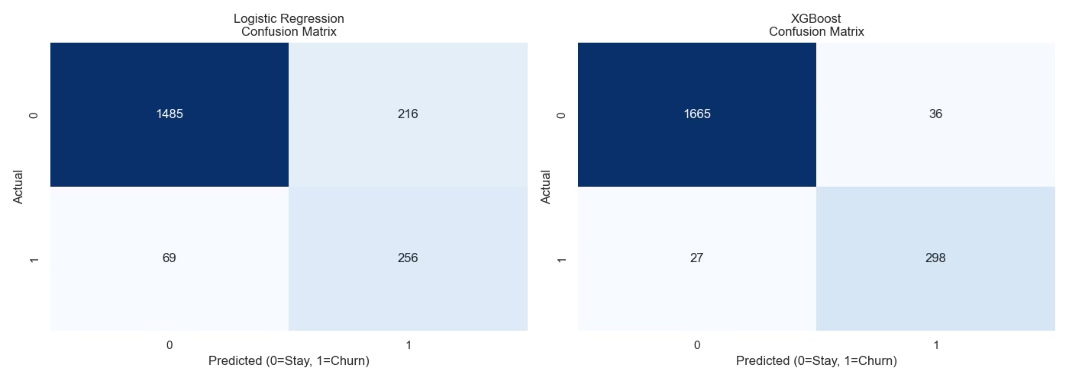
Logistic Regression Confusion Matrix

Slide 10
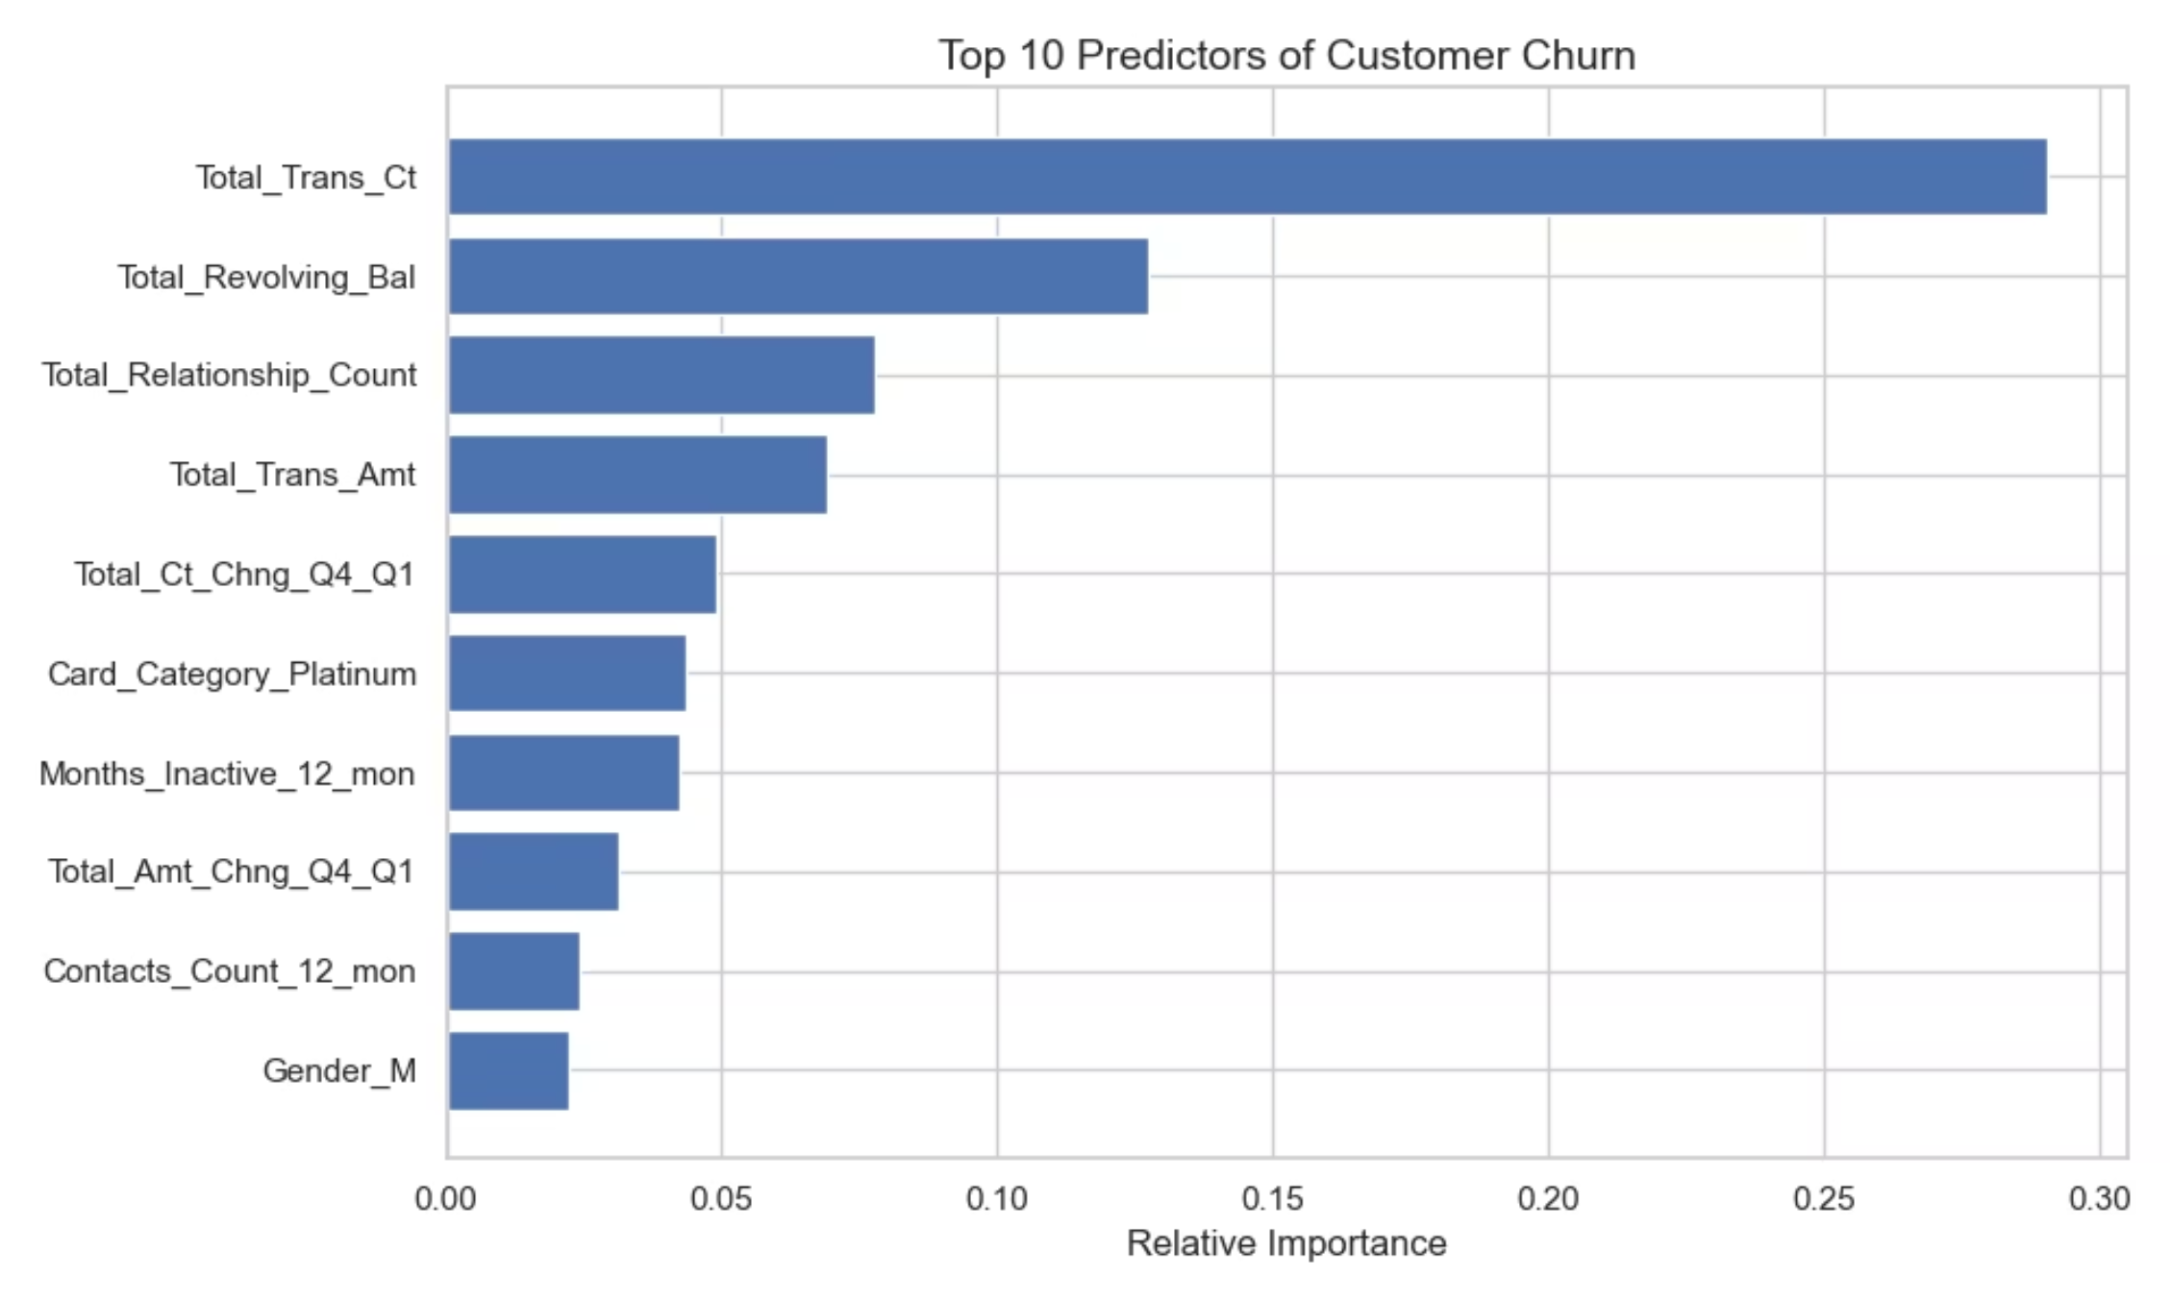
XGBoost Confusion Matrix

Slide 11
Conclusions & Actionable Recommendations
Conclusion
The XGBoost model successfully solves the problem, identifying 90%+ of at-risk customers with high precision
Actionable Business Recommendations
Alert System
Activation Campaigns
Bundling
Flag customers whose monthly transaction count drops below 40
Target customers with $0 revolving balance with "Cashback on Credit Usage" offers to re-engage them
Offer incentives for credit-card-only customers to open a Savings account, increasing their "stickiness"

